Slide 1


Darkness Lesson 9: Deception

Slide 2

Notes:
In speaking of the devil, Jesus said, “He was a murderer from the beginning, and does not stand in the truth because there is no truth in him. Whenever he speaks a lie, he speaks from his own nature, for he is a liar and the father of lies” (John 8:44). The devil will do all he can to cast a looming shadow of darkness in his lies to keep us from seeing the true Light of Hope in God’s eternal goodness. There are three great deceptions which we must be enlightened by the Light of Truth to make sure we are not led astray by the devil.

Slide 3


“From the fruit of the trees of the garden we may eat; but from the fruit of the tree which is in the middle of the garden, God has said, ‘You shall not eat from it or touch it, or you will surely die.”
Gen. 3:2-3
Notes:
Deception 1: Since God Often Says, ‘No,’ He Can’t Possibly Be Good
This deception is the first one Satan laid before mankind and ultimately led to our current corrupt existence in this world when Eve fell for it. In describing the true skill in the art of deception, Moses wrote of the devil, “Now the serpent was more crafty than any beast of the field which the LORD God had made,” (Gen 3:1). From the very first words, the devil spoke through the form of a serpent (Rev. 12:9; 2 Cor. 11:3). We get a taste of how good he is at twisting our minds and thoughts to accept a faulty logic about the nature of God when the devil said to Eve: “Indeed, has God said, ‘You shall not eat from any tree of the garden’?” (Gen 3:1). As much as I loathe and detest the murderous nature of Satan to destroy our eternal souls and us, I cannot help but stand in awe of his true skill in the art of deception with this statement.

Slide 4

Since God Often Says “No,” He Can’t Possibly Be Good
“The serpent said to the woman, ‘You surely will not die! For God knows that in the day you eat from it your eyes will be opened, and you will be like God, knowing good and evil.”
Gen. 3:4-5
Notes:
In Genesis 3:1, Satan lures Eve into a theoretical discussion on the logic of God’s goodness. He forces Eve to ponder and wrestle with the reality of what God has done against the obvious logical assumption of his stated premise. Obviously, God did not create a world full of delicious food which by His own admission declared to be “Good” only to tell Eve she could not have any of it. This clearly would be the definition of a God who was “bad.” So if Eve would agree this would certainly make God “bad” to create a world where you couldn’t have anything, then logically the opposite would have to be true. Since it would be bad for God to say you cannot have anything, then God can only be good by saying you can have everything. However, Eve is tripped up in declaring this theoretical description of God in her defense of His goodness by admitting He actually hasn’t said you could eat anything. And it is at this moment where Satan’s deception takes full root.
Eve wrestles with this logical inconsistency of a God who clearly is not “Bad” by the serpent’s definition but must somehow still be “Good” even though the logic does not seem to support it. Eve defends God’s created goodness stating that, yes, God’s goodness can be observed by His permissiveness, since he said we could eat from any of the trees in the garden...well...that is...wait...except this one. “The woman said to the serpent, ‘From the fruit of the trees of the garden we may eat; but from the fruit of the tree which is in the middle of the garden, God has said, ‘You shall not eat from it or touch it, or you will surely die’” (Gen 3:2-3).
Now Satan has Eve stuck contemplating what seems to be a glitch in the logical assumption that God’s goodness is verified by His permissiveness. Because she acknowledges God’s restrictive command regarding the tree of the knowledge of good and evil, it would seem she now has to atone for this lone exception to the permissive nature of God’s goodness and explain how it can possibly fit into the character of a good God.

Slide 5

“Behold, the man has become like one of Us, knowing good and evil; and now, he might stretch out his hand, and take also from the tree of life, and eat, and live forever.” Gen. 3:22
Notes:
In this mental battle of accounting for how God can still be seen as good while restricting her from something that on the surface appears to be so good, Satan slips in another lie. “The serpent said to the woman, ‘You surely will not die! For God knows that in the day you eat from it your eyes will be opened, and you will be like God, knowing good and evil,’” (Gen 3:4-5). This final death blow of the supposed sinister explanation behind God’s restrictive order makes it impossible for Eve to defend God’s goodness any longer. Embracing Satan’s deception, Eve follows her own determination of what is truly good rather than trust God’s knowledge and direction. “When the woman saw that the tree was good for food, and that it was a delight to the eyes, and that the tree was desirable to make one wise, she took from its fruit and ate; and she gave also to her husband with her, and he ate,” (Gen 3:6).

Slide 6
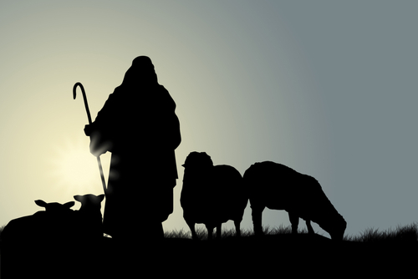
Jesus, the Good Shepherd, Leads Us To Find Living Water
“Truly, truly, I say to you, I am the door of the sheep. All who came before Me are thieves and robbers, but the sheep did not hear them. I am the door; if anyone enters through Me, he will be saved, and will go in and out and find pasture. The thief comes only to steal and kill and destroy; I came that they may have life, and have it abundantly.” Jn. 10:7-10

Slide 7
Deprived Of Immediate Gratification Is A Life of Slavery
“For we also once were foolish ourselves, disobedient, deceived, enslaved to various lusts and pleasures, spending our life in malice and envy, hateful, hating one another.”
Titus 3:3

Slide 8
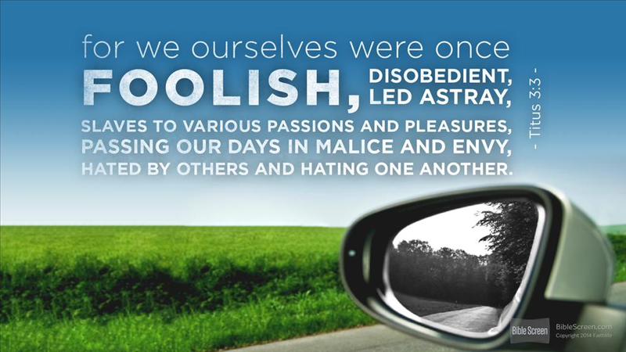

Slide 9

“...they exchanged the truth about God for a lie...”
Romans 1:25
“As the song we wrote is that we wrote, Paul and me, ‘Money Can’t Buy Me Love,’ it’s true. The point is this. I want happiness, I don’t want to keep up with drugs...
...Explain to me, what Christianity can do for me. Is it phony? Can He love me?...”

Slide 10
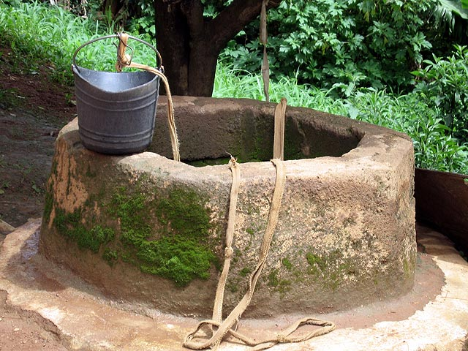
Joy Vs. Happiness
“Everyone who drinks of this water will be thirsty again, but whoever drinks of the water that I will give him will never be thirsty forever. The water that I will give him will become in him a spring of water welling up to eternal life,” Jn. 4:13-14

Slide 11
To Find Joy, Pursue The Things That Make You Happy
“Make my joy complete by being of the same mind, maintaining the same love, united in spirit, intent on one purpose. Do nothing from selfishness or empty conceit, but with humility of mind regard one another as more important than yourselves; do not merely look out for your own personal interests, but also for the interests of others.”
Philip. 2:2-4

Slide 12


Let Steadfastness Have Its Full Effect
But if we hope for what we do not see, we wait for it with patience.
Rom. 8:25
...we rejoice in our sufferings, knowing that suffering produces endurance, and endurance produces character, and character produces hope, and hope does not put us to shame, because God’s love has been poured into our hearts...
Rom. 5:3-5

Slide 13
Let Steadfastness Have Its Full Effect
I am overflowing with joy in all our affliction.
2 Cor. 7:4

Slide 14
Notes:
Conclusion
The devil has always used deception to blind humanity to reality. To make us think some immediate sinful gratification denied means God is not good. He blinds us to the joy of being selfless instead of selfish, thus enslaving us to sin.

